Slide 1



SORTING VISUALIZER
Team 8 | DSAI
Pham Quang Hieu 20194432
Nguyen Van Thanh Tung 20194459
Merge Sort
Shell Sort
Nguyen Vu Thien Trang 20194459
Selection Sort

Slide 2
PROBLEM STATEMENT
Selection Sort
Merge Sort
Shell Sort
PROBLEM
Design
TARGET
Explaining and visualizing different sorting algorithms
Design an UI for the problem with different features
Help users have a better insight about how algorithms work

Slide 3
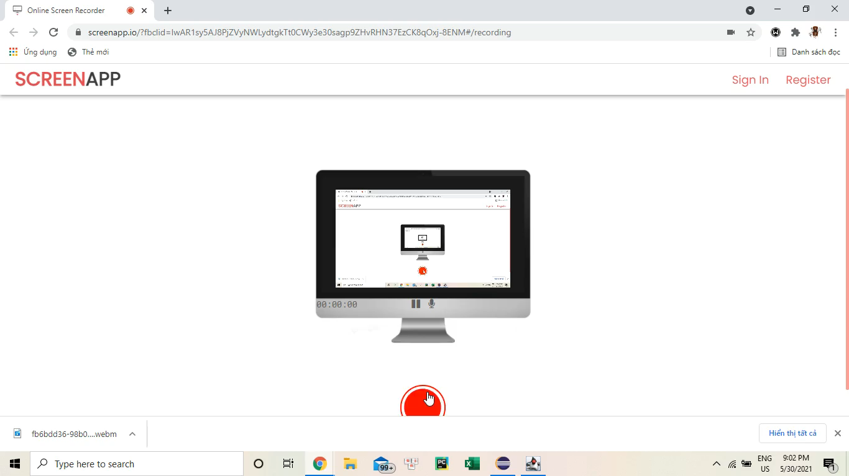
DEMO VIDEO

Slide 4
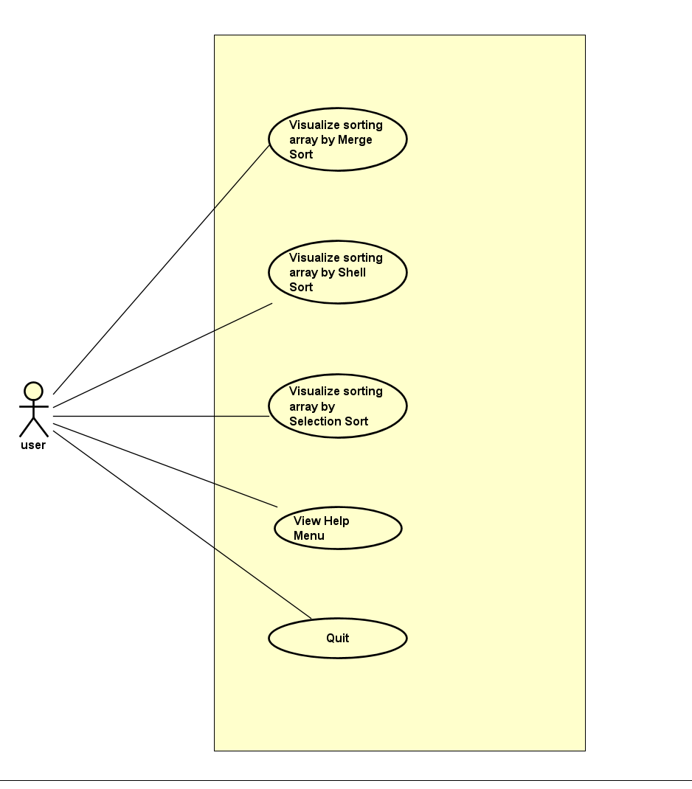
USE CASE DIAGRAM
Users can start visualizing by select a sort type
Take all user command from the GUI
Notice the user if there is anything wrong with his input
Run the designated algorithm
Run/Reset the visualization based on user command.
Users can view the help menu
Users can quit the program

Slide 5
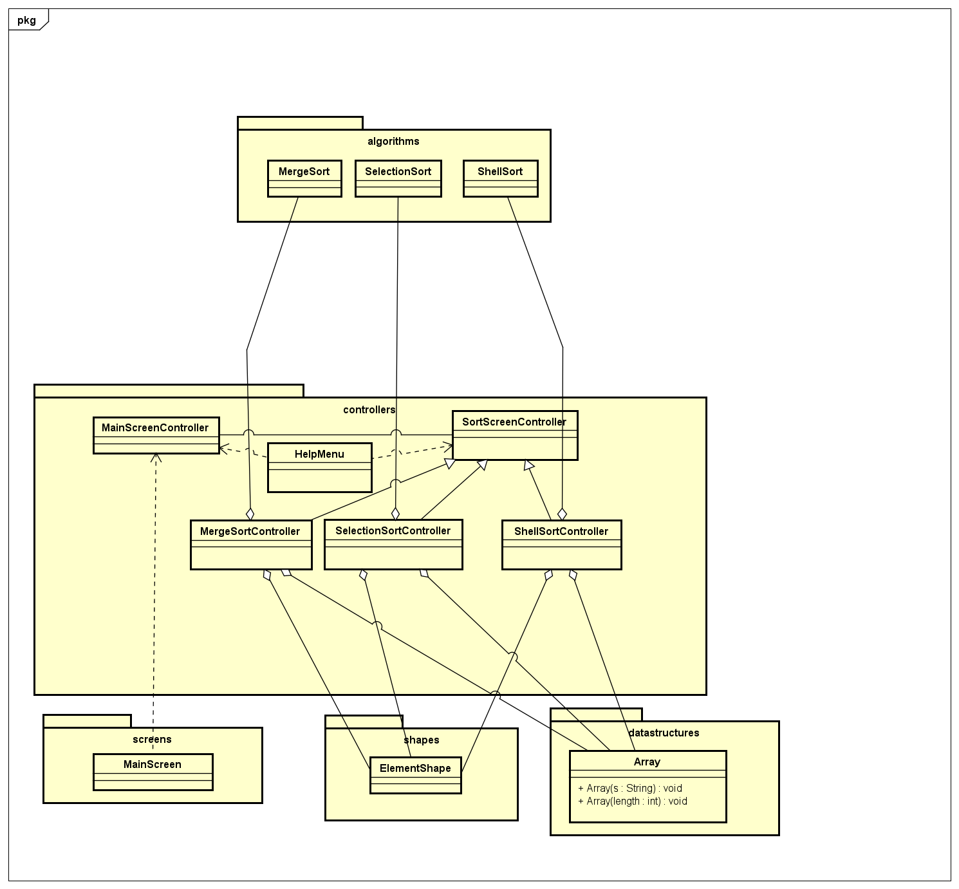
CLASS DIAGRAM
Package datastructures: store the main data structure (customized array).
Package algorithms: store 3 sorting algorithms for visualizing.
Package controllers: store all the screen controllers.
Package main screen: store the main screen class of the application.
Package shapes: store the class ElementShape which is used for visualization in the GUI.

Slide 6
Array & Shape
Array
Shape
Two constructors for customizing and randomizing a new array
Clone method for cloning an array
A getter for array’s length
Handle user input exception
3 main constructor represents 3 different shape types used for different purpose of visualization. There are two types of TranslateTransition.

Slide 7
PACKAGE ALGORITHMS
SelectionSort
MergeSort
ShellSort
Sort an original array of integers and an customized array of shapes
Getters for transitions, shapes state at each steps
Sort an original array, then encode the sorting process, and corresponding UI effect into an array, called steps
Sort an original array of integers, store necessary data for the process. Provide Getters for transitions, state of array at each steps.

Slide 8
PACKAGE CONTROLLERS
SelectionSortController
ShellSortController
MergeSortController
Sort the array by merge sort, then take the encoded “steps” array. Finally, decode and put it on the UI.
Sort the array by selection sort, then display the stored “states” to corresponding step.
Sort the array by shell sort, display the stored “states” corresponding to User Action by system of ButtonListener.
SelectionSortController

Slide 9
AWESOME WORDS
THANKS FOR YOUR ATTENDING !

